Slide 1

Agile Methodology
Agile model is an Iterative and Incremental process.

Slide 2
Agile Principles
Customer doesn’t have to wait for long time to get their required feature
Develop, test and release piece of software to the customer with few number of features from the whole product.
Requirement changes can be accepted/accommodated in any stage
There will be a good communication between Customer, Business Analyst, Developers & Testers.

Slide 3
Advantages
Disadvantages
Requirement changes are allowed in any stage of development.
Releases will be very fast(weekly)
Customer doesn’t need to wait for long time
Good communication between team
It is very easy model to adopt.
Less focus on documentation since we deliver software very faster.

Slide 4

Scrum
Scrum is a framework through which we build software product by following Agile Principles.
Scrum includes group of people called as Scrum team. Normally contains 5 – 9 members.
Product Owner
Scrum Master
Dev Team
QA Team

Slide 5
Product Owner
Collect details from customers and defines the features of the product.
Prioritize features based on market value
Adjust features and priority every iteration , as needed.
Accept or reject the work results.
Scrum Master
The main of the scrum master is to facilitate and drive the agile process.
Developers and QA
Develop and test the software

Slide 6
Scrum Terminologies
User Story - A Feature/module in a software
Epic - Collection of User stories
Product backlog - Contains list of user stories. Prepared by Product owner.
Sprint/Iteration - Period of time to complete the user stories, decided by the product owner and team, usually 2 -4 weeks of time.
Sprint Backlog – List of committed stories by Dev/QA team for specific Sprint

Slide 7
Scrum Terminologies
Sprint Planning meeting - Meeting conducts with the team to define what can be delivered in the sprint and duration .
Scrum Meeting – Meeting conducted by Scrum master everyday for 15 minutes. Called as Scrum call/Stand up meeting.
What did you do yesterday?
What will you do today?
Are there any impediments in your way?
Sprint Retrospective meeting - Meeting conducted after completion of the sprint. Entire team should participate .
Story Point – Rough estimation for user stories will be given by Dev and QA team in the form of Fibonacci series.
Burn down chart – Graphical representation shown how much work completed on day to day basis. Maintained by Scrum Master

Slide 8
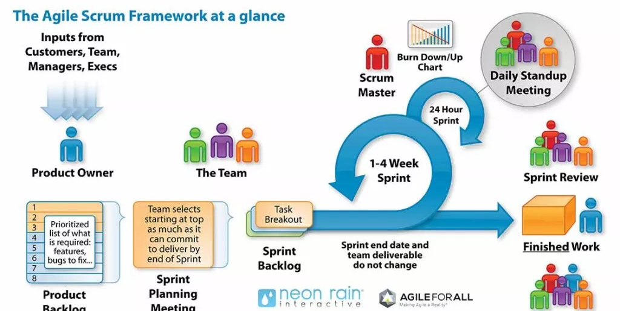

Slide 9
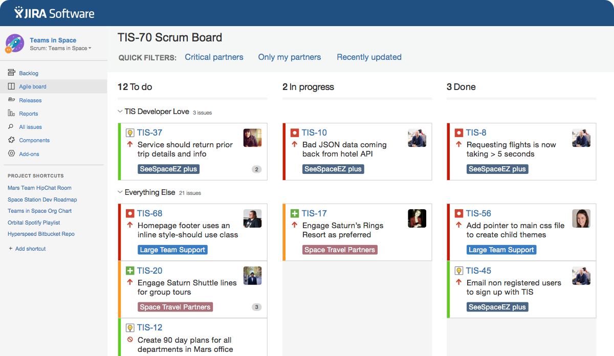
Sample Screenshot - JIRA

Slide 10
Thank you

